Slide 1

Convolutional Neural Networks
Convolutional neural network example
deeplearning.ai

Slide 2
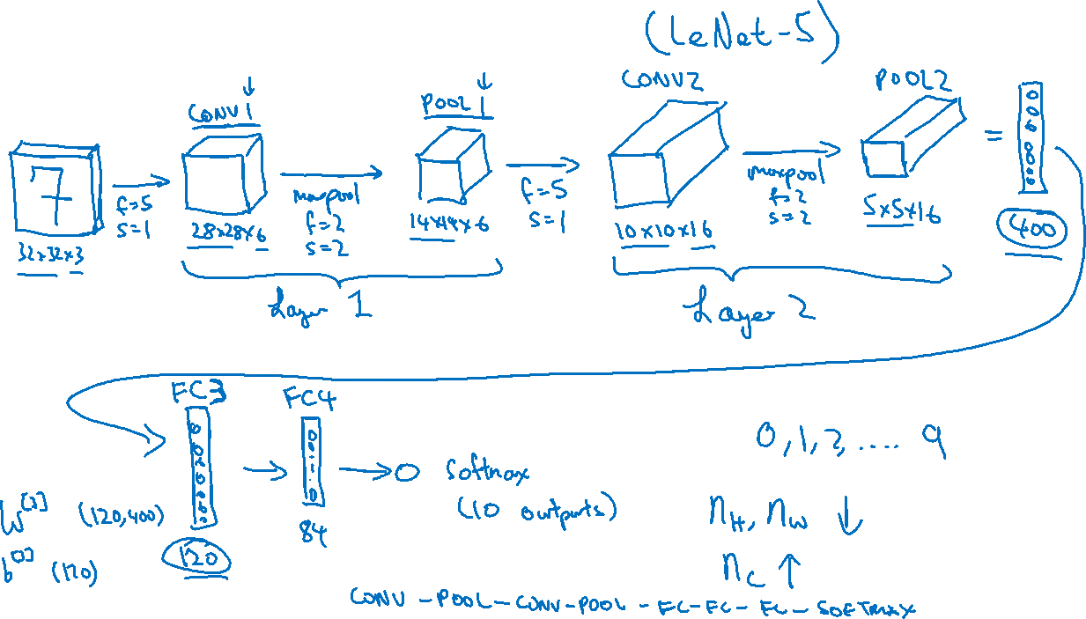
Neural network example

Slide 3
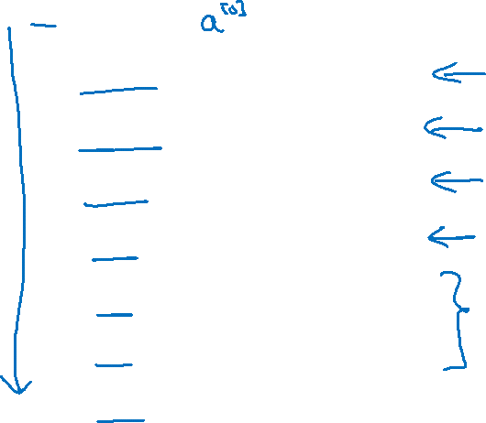
Neural network example
 | Activation shape | Activation Size | # parameters
Input: | (32,32,3) | 3,072 | 0
CONV1 (f=5, s=1) | (28,28,8) | 6,272 | 208
POOL1 | (14,14,8) | 1,568 | 0
CONV2 (f=5, s=1) | (10,10,16) | 1,600 | 416
POOL2 | (5,5,16) | 400 | 0
FC3 | (120,1) | 120 | 48,001
FC4 | (84,1) | 84 | 10,081
Softmax | (10,1) | 10 | 841

